Slide 1
Texture Analysis for Retinoblastoma Classification Using Ultra-wide-field Retinal Fundus Images Student: He Shengya Student ID: 1155239361 Supervisor: Dr.Jack Lee Date: Feb,24

Slide 2
Outline
The Critical Challenge of RB
Limitations of Current Diagnostics
The Gap in AI: Black Box Problem
My Proposed Solution: Texture Analysis
Research Question & Objectives
Study Design & Data Source
Methodology Overview
Current Progress

Slide 3
The Critical Challenge of Retinoblastoma (RB)
Disease Burden & Urgency
Most common primary intraocular malignant tumor in children⁽¹⁾
(>70% diagnosed under age 2).
Global burden: 8,000-9,000 new cases annually⁽⁶⁾.
China: ~1,100 new cases per year⁽⁷⁾.
Disability-Adjusted Life Years (DALYs) are projected to rise by 2040 despite declining cases⁽⁸⁾
Life-threatening if metastasized: Survival rate <50% post-extraocular spread.⁽⁴⁾
This burden is not equally distributed, children face worse outcomes in lower SDI (sociodemographic index) regions due to Insufficient clinician awareness and accessible, low-cost screening tools⁽⁵⁾

Slide 4
Current Diagnostic Methods – Trade-offs
Accurate diagnosis requires the integration of multimodal information⁽⁹⁾
Pathologically key diagnostic clue: Intraocular masses with calcification.⁽¹¹⁾
Key Gap: Low detection rate for early-stage tumors (small size, low calcification) → false negatives⁽¹⁵⁻¹⁹⁾
Patient Challenge: Young age leads to poor compliance, affecting exam quality.
Method | Strengths | Limitations
Ultrasound⁽¹²⁾ | Accessible, simple | Limited precision for calcifications
CT^{(10,13)} | High sensitivity for calcification (~90%) | Ionizing radiation (safety concern in children)
MRI⁽¹⁴⁾ | Best for invasion/metastasis | Less sensitive for tumor tissue
Fundus Photography⁽²⁰⁻²²⁾ | Non-invasive, effective screening occult, potentially blinding chronic eye diseases | Requires specialized expertise

Slide 5
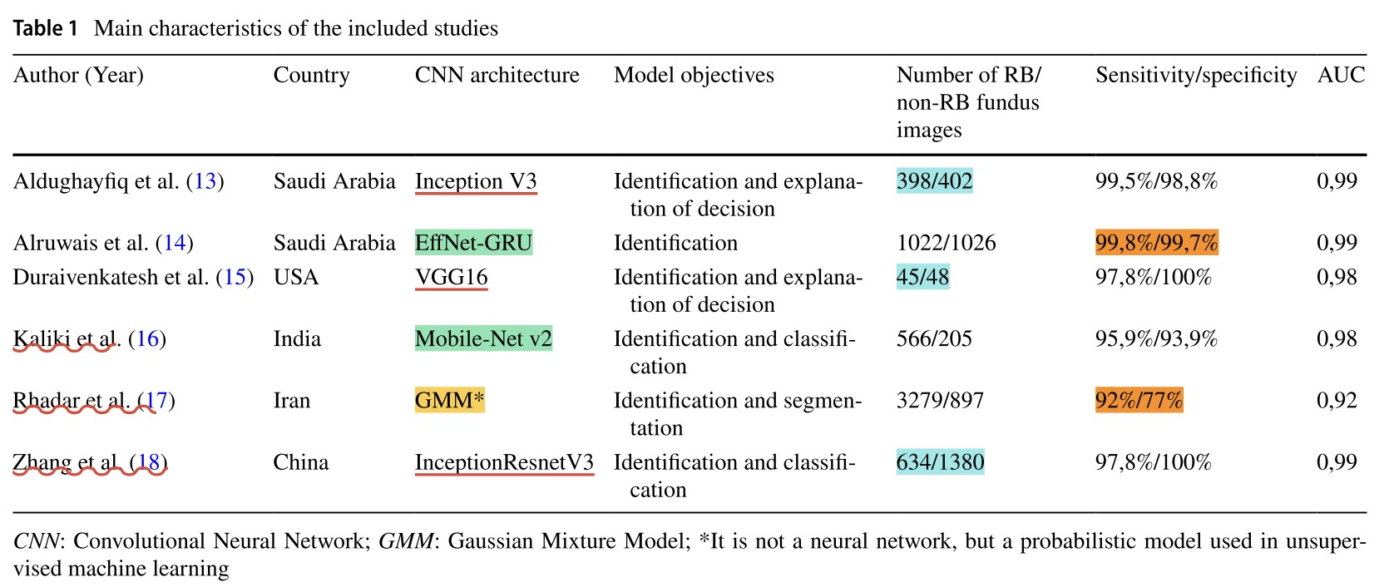
Fundus Photography & AI
· Current studies mainly use retrospective CNN(Convolutional Neural Network)-based deep learning models show impressive results.(AUC: 0.92-0.99)
· AI excels at detecting obvious RB signs like leukocoria but often misses early-stage cases, so more accurate AI-assisted methods are still needed.
· However, it requires massive datasets, incurs high computational costs, risks overfitting, and lacks interpretability due to its black-box nature

Slide 6
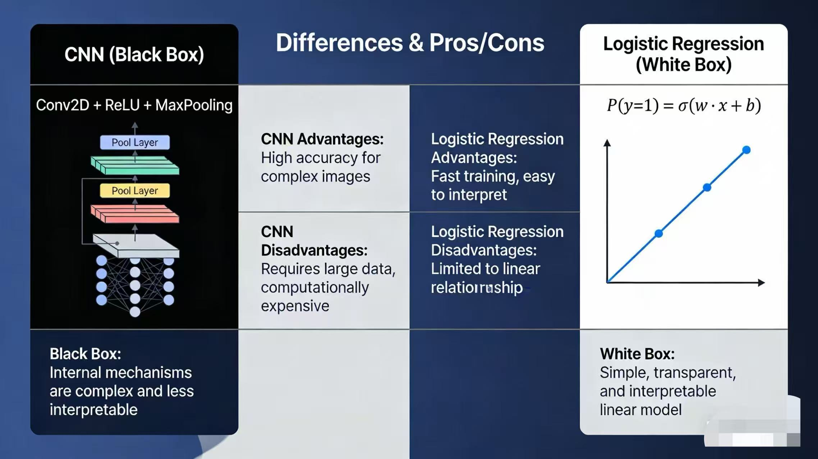
CNN vs LR
DL automatically learns image features
DL performs well but lack of interpretability is a major barrier to trust and adoption⁽³¹⁻³⁴⁾

Slide 7
My Solution – Texture Analysis & LR
What is texture analysis?
Texture: a set of quantifiable, intimate metrics of the images surface using a spatial arrangement of gray values to shows quantifies patterns, structures, and intensity variations in images, providing sufficient information from the point of human visual perception (contrast, roughness..)⁽³⁸⁾
Advantages:
✅ Interpretable – Features have physical meaning (potentially link to underlying biology, such as tumor calcification or tissue density)
✅ Multiple methods to choose（LBP、GLCM、 FRACTAL、 HOS... >10）
✅ Minimal preprocessing, Computationally efficient, Suitable for resource-limited settings⁽³⁵⁻³⁶⁾
Texture analysis offers a middle ground—it quantifies image properties into measurable features that we can interpret and link to biology.

Slide 8
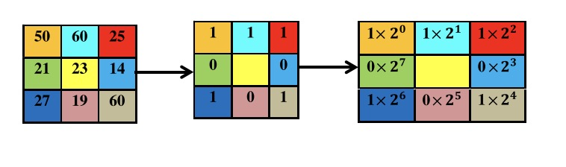
Intrested texture Method– Local binary pattern
What is Local binary pattern-LBP? why interseted in?
LBP is a statistical method that summarizes the local structure of the image efficiently by comparing each pixel with all surrounding neighboring pixels⁽³⁹⁾
The success of LBP in image analysis can be justified by the fact that in the Beijing Olympics 2008 Chinese officials use the LBP technique for biometric verification of a huge mass of visitors from the whole world.
biologically plausible：Key diagnostic clue is intraocular masses with calcification，LBP may highly sensitive to local microstructures (such as microcalcifications and microvascular clusters)
Advantages⁽³⁹⁾
a. It is having high discriminative power.
b. It is having computational simplicity.
c. It is invariant to grayscale changes.

Slide 9
Research Question & Objectives & Hypothesis
Primary Question:
Can we explore an alternative interpretable texture-based logistic regression model for RB that performs well compara to CNN ?
Secondary Questions:
Which texture method performs best?
LBP vs. Haralick vs. Fractal analysis vs. HOS vs. Combine
Objective: My study aims to find an interpretable alternative to black-box AI and identify which texture methods best classify RB.
Hypothesis: the performance of clinical texture-based regression model is not less than CNN model.

Slide 10
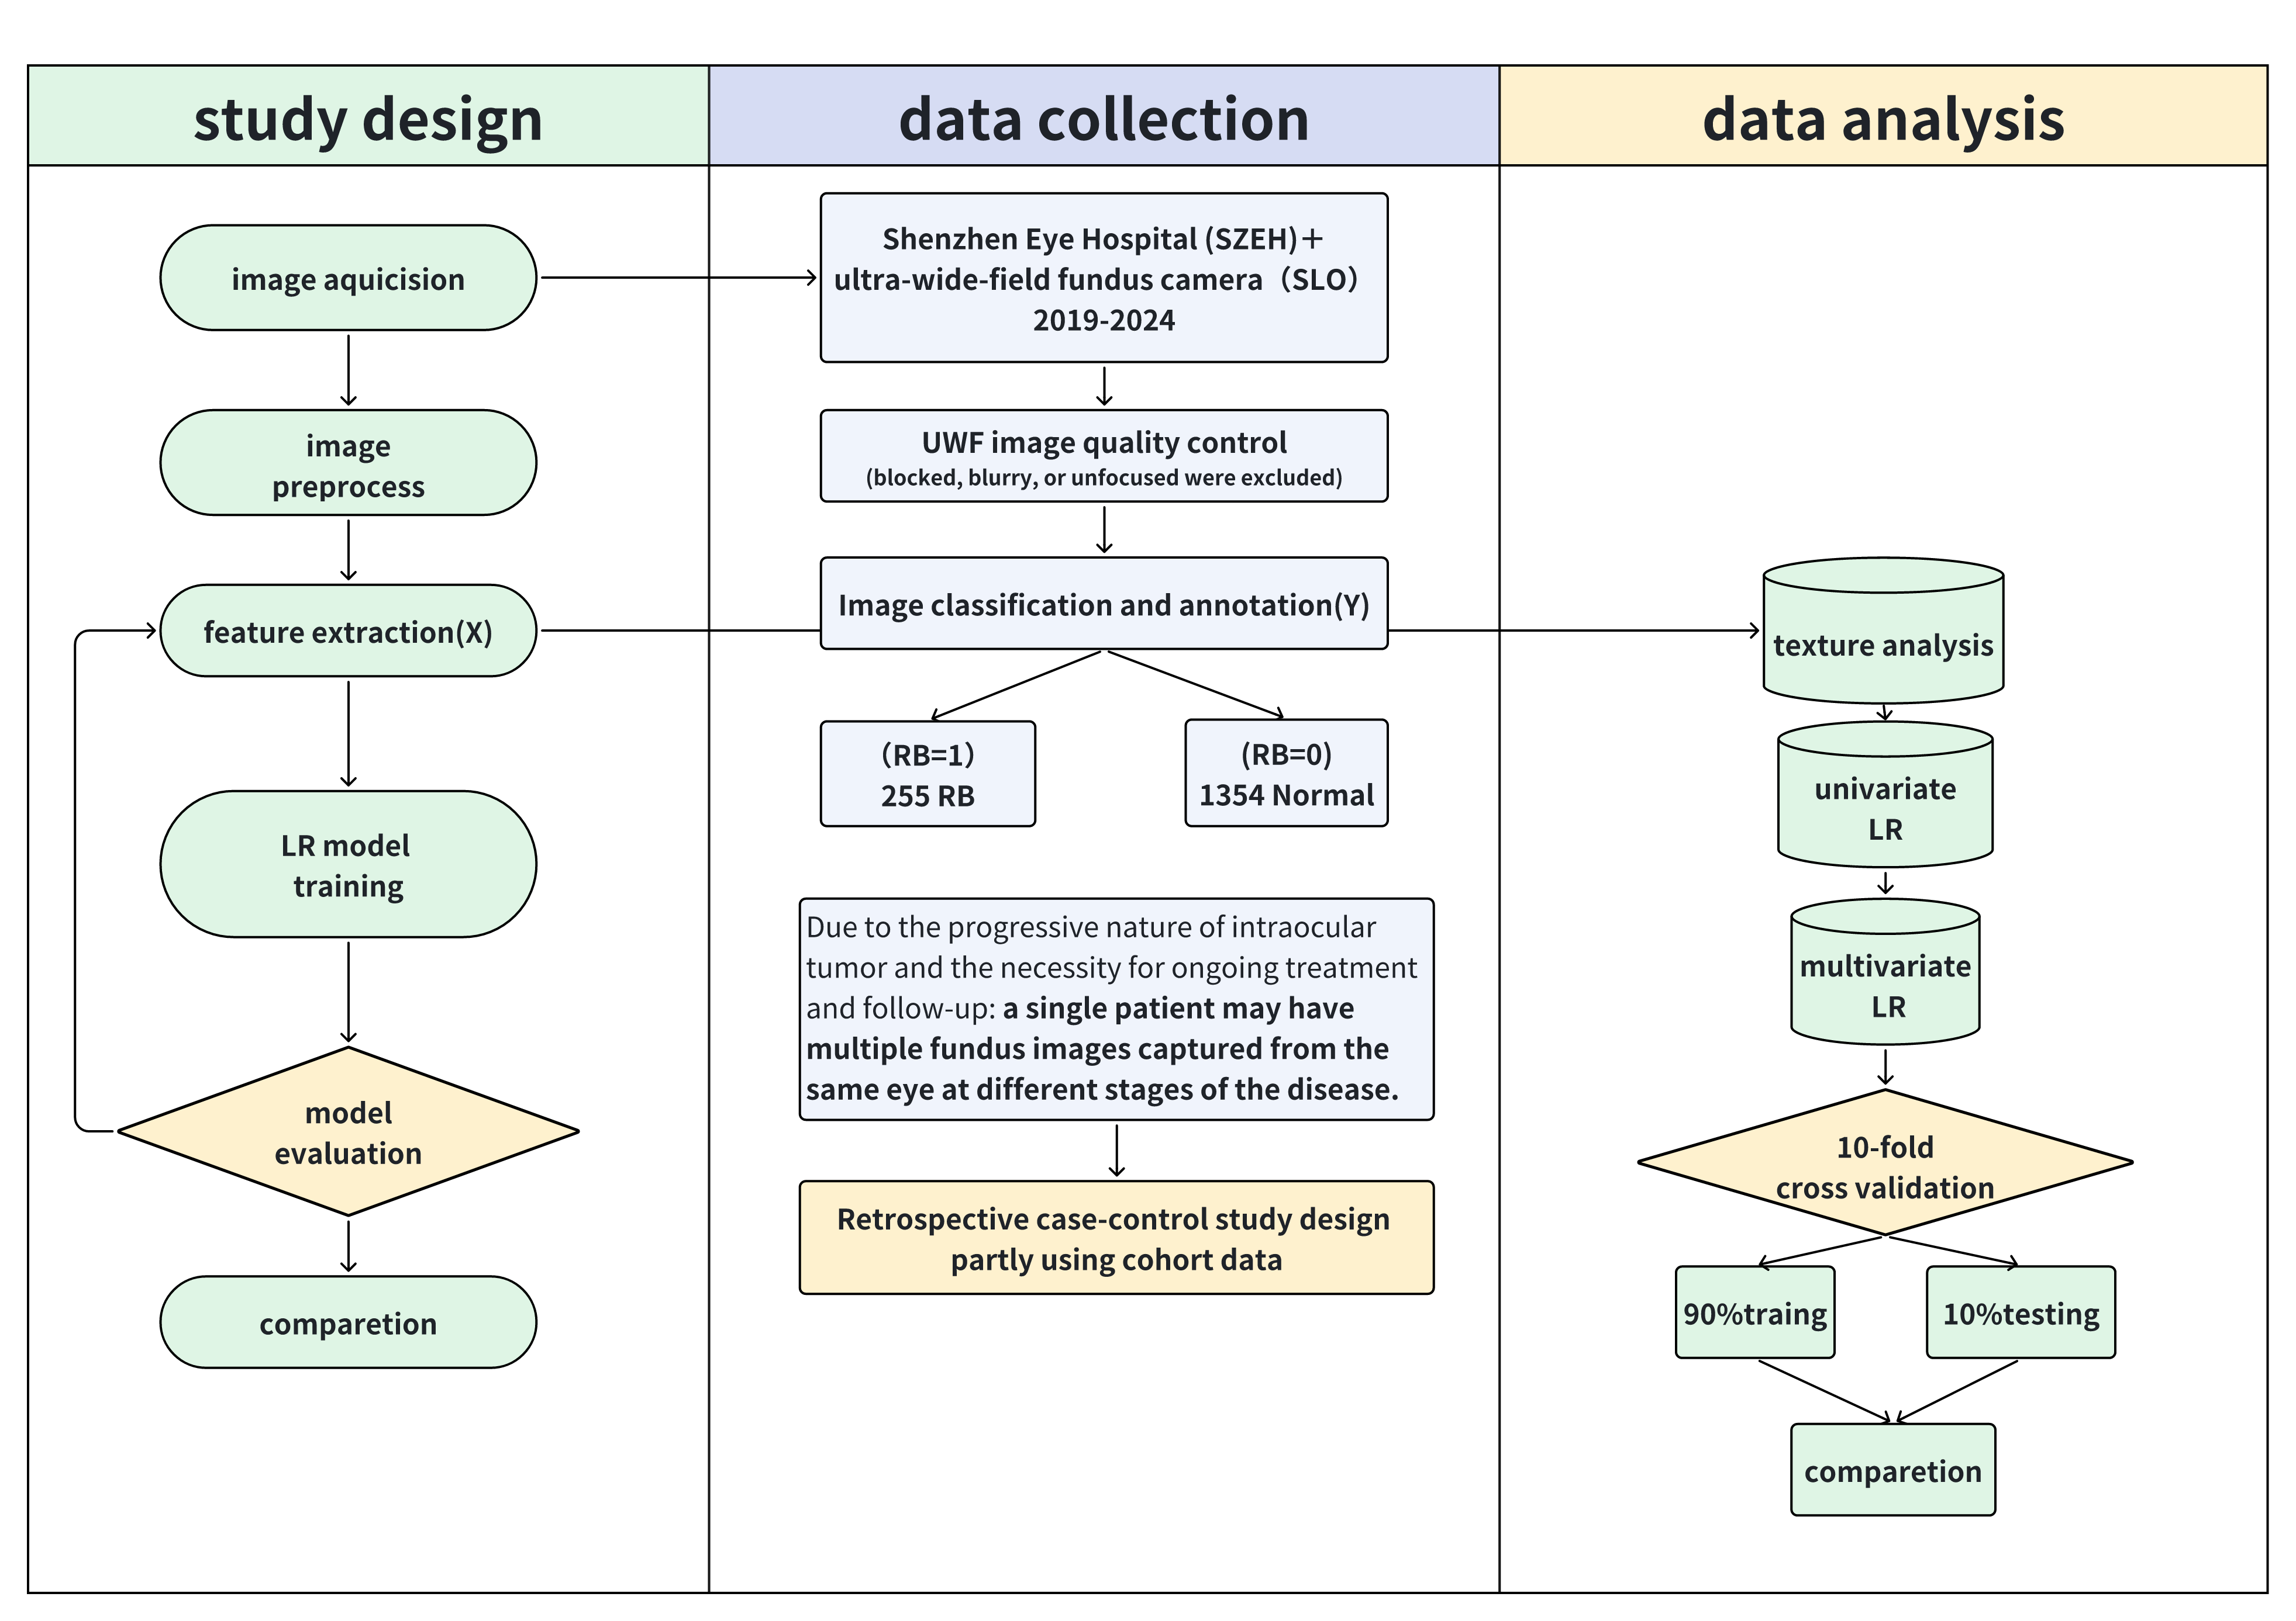
Study Design
Study Unit：image（pixel）
Sample size: 765 (255 RB + 510 Normal)
Study Design：retrospective case control study
interested Exposure：LBP features
Outcome：diagonal RB
Covariate：other textures

Slide 11
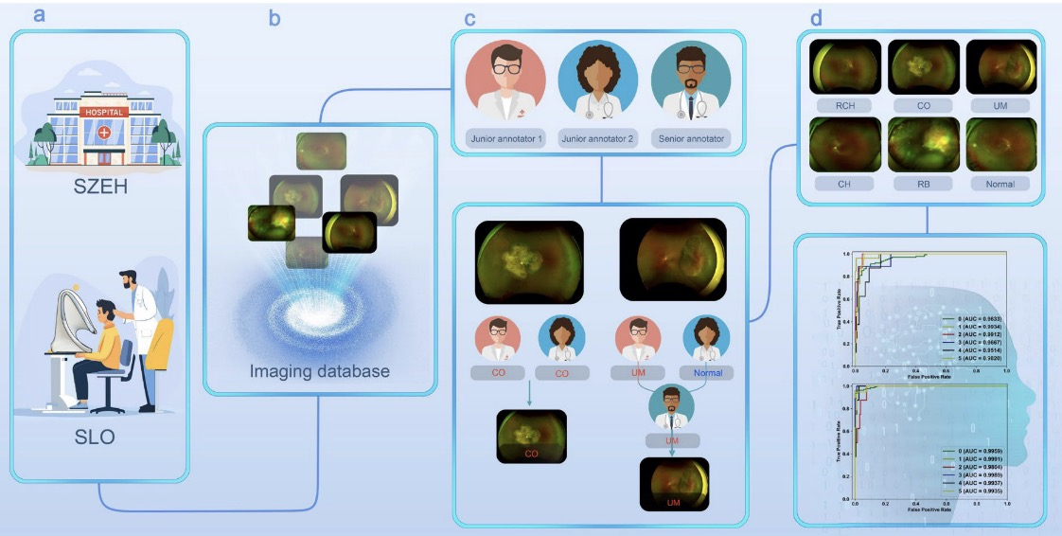
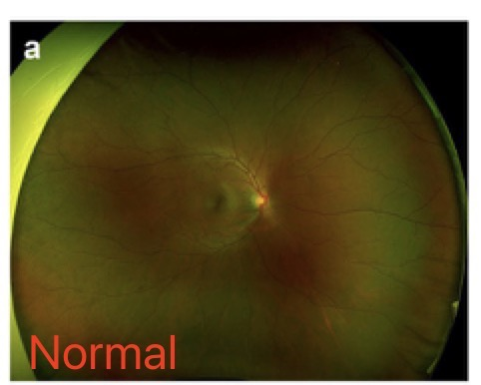
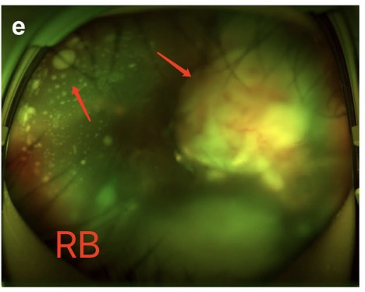
Image collection & Annotation & Quality Control
· Shenzhen Eye Hospital using camera SLO⁽⁹⁾ Within 5 years(2019-2024),
· 255 UWF RB images from 22 patients and 1354 healthy images from 124 patients
· Simple random sampling at a case-control ratio of 1:2：510 normal images.
· Fundus images that were blocked, blurry, or unfocused were excluded
· Each UWF image was independently classified by two junior annotators independently. In cases of inconsistent classifications, a senior annotator reviewed and reclassified the images to ensure accuracy.

Slide 12
Methodology – Feature Extraction
ARIA (Automatic Retinal Image Analysis) extracts four textures(Patent):
· Local Binary Patterns LBP -local texture / 80
· Haralick - statistical texture /8
· Fractal - self-similarity and complexity /6
· HOS (Higher Order Spectra) - non-linear and non-Gaussian patterns /19
using ARIA to obtain four individual texture features for comparison.
1.LBP 2.HOS 3.Haralick& Fractal 4.Combine

Slide 13
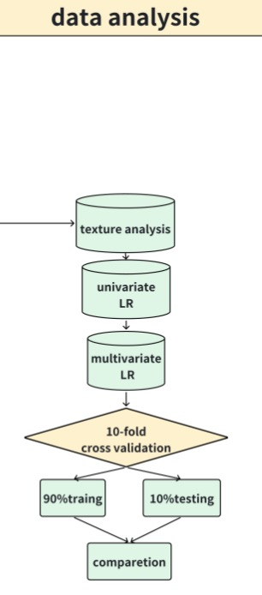
Methodology – Feature Selection & Model Building
Step 1: Univariate logistic regression for each feature (p<0.05 to enter)
Step 2: Multivariate logistic regression with backward elimination (p<0.1 to stay)
Step 3:using selected features generate Model
Software: MATLAB 2020a (feature extraction),
SPSS V.20 /Vscode (statistical analysis)

Slide 14
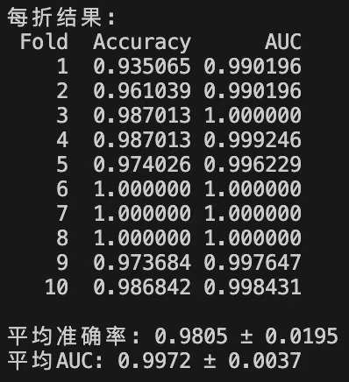
Methodology – Validation & Performance Comparison
Validation: 10-fold cross-validation
·Data split into 10 subsets:
Train on 9, test on 1
Repeat 10 times, use average results
·Performance Metrics:
Sensitivity, Specificity, Accuracy,Area Under ROC Curve (AUC)

Slide 15
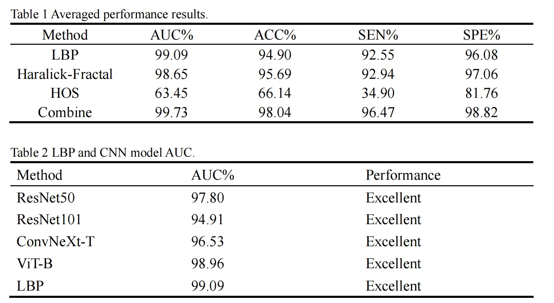
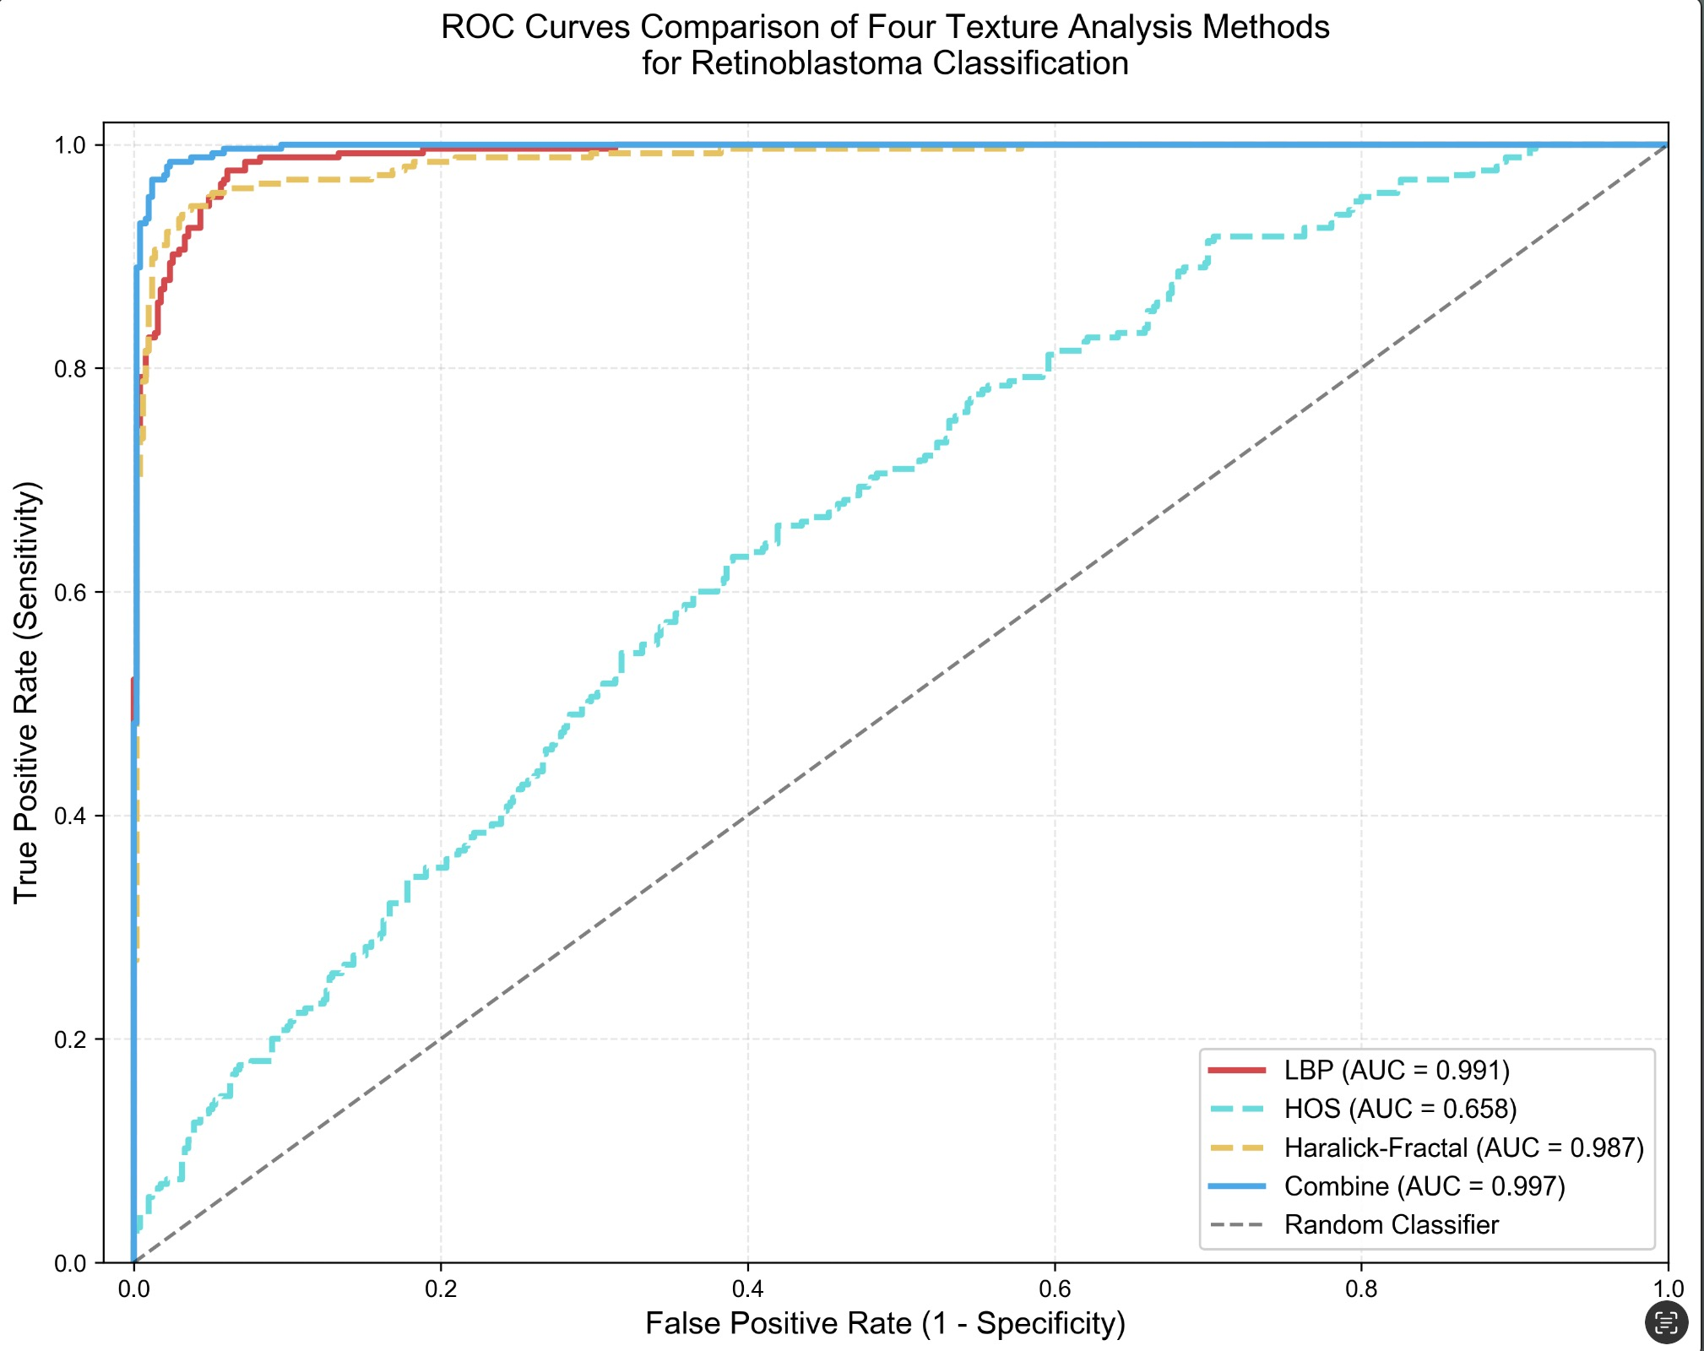
Result

Slide 16
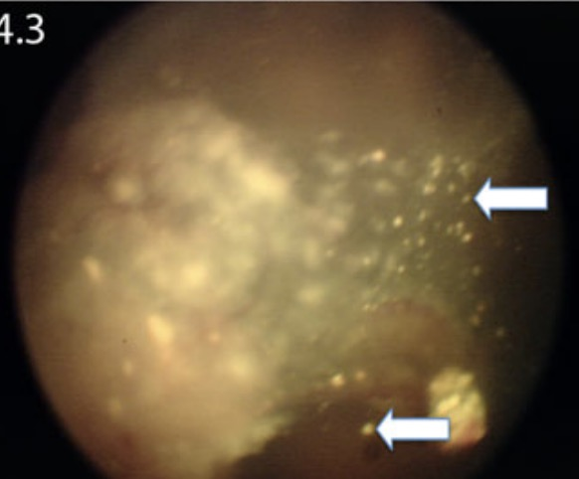
Discussion
The following parameters were evaluated by ophthalmoscopy with histopathology as the gold standard: tumour growth pattern, iris neoangiogenesis, presence of retinal detachment and vitreous seeds, and prelaminar optic nerve involvement. ⁽⁴⁶⁾
Early endophytic tumors present as small, flat, transparent or pale white lesions
→ extend into the vitreous body
→ lack of adhesion between tumor cells
→ detach, implant, or float in the vitreous⁽⁴⁷⁾
→ The fundus images reveal white or grayish-white elevated lesions with focal bright white spots and scattered multiple vitreous seeds.
· LBP：
Areas such as the calcified elevated regions of the tumor and the focal vitreous seeding zones appear lighter in color, denser, with higher contrast and greater grayscale differences compared to the surrounding areas. Some may even be invisible to the naked eye, but LBP can better capture more subtle, localized changes compared to other methods.
Vitreous seeding

Slide 17
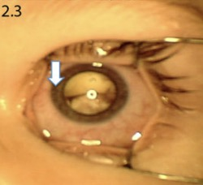
Discussion
·Fractal：
Abnormal blood vessels are present on the iris surface. Studies have shown that the fractal dimension exhibits a high degree of sensitivity with respect to new vessel formation⁽³⁷⁾.
·Haralick：
entropy, mean value, contrast, and correlation based on MR images showed statistically significant differences between benign and malignant orbital tumor groups, suggesting a potential correlation between RB tumor changes and pixel gray-level statistics⁽⁴⁹⁾.
·HOS：
The relatively low AUC of HOS in this study may be attributed to it is sensitive to image illumination conditions, studies have shown that UWF images may exhibit peripheral distortion and unnatural colors in the retina⁽⁵¹⁾
iris neoangiogenesis

Slide 18
Discussion
·Strength：
1. Innovative exploration of using texture-based logistic regression classifier compared to previous CNN- based methods, it achieves comparable performance while enhancing model interpretability.
2. Emerging UWF imaging systems can capture 200° panoramic retinal images, in contrast to the 30° to 45° field of view provided by traditional color fundus photography⁽⁵²⁾. it facilitates early lesion identification and enables more accurate monitoring of tumor progression since tumors often extend to or originate in the peripheral retina⁽⁵³⁾
·limitations：
1. relatively small sample size .
2. merely exploratory study, it did not include more detailed info like staging classification and relevant clinical data, which limited more in-depth clinical research and failed to fully reflect the complexity and variability encountered in clinical practice, its effectiveness and reliability in actual medical applications remain unclear.
·Future research：
incorporating more diverse and representative datasets, including those with a typical or ambiguous presentations, as well as richer background information.

Slide 19
Reference
1. Dimaras H, Corson TW. Retinoblastoma, the visible CNS tumor: A review. J Neurosci Res. 2019;97(1):29–44.
2. Byroju VV, Nadukkandy AS, Cordani M, Kumar LD. Retinoblastoma: present scenario and future challenges. Cell Commun Signal. 2023;21(1):226.
3. Warda O, Naeem Z, Roelofs KA, Sagoo MS, Reddy MA. Retinoblastoma and vision. Eye (Lond). 2023;37(5):797–808.
4. Shields CL, Shields JA. Here Comes the Sun … for Retinoblastoma. Asia Pac J Ophthalmol (Phila). 2021;10(4):341–2.
5. Tomar AS, Finger PT, Gallie B, Mallipatna A, Kivelä TT, Zhang C, et al. A Multicenter, International Collaborative Study for American Joint Committee on Cancer Staging of Retinoblastoma: Part I: Metastasis-Associated Mortality. Ophthalmology. 2020;127(12):1719–32.
6. Zhao J, Feng ZX, Wei M, Liu G, Solarte CE, Li B, et al. Impact of Systemic Chemotherapy and Delayed Enucleation on Survival of Children with Advanced Intraocular Retinoblastoma. Ophthalmol Retina. 2020;4(6):630–9.
7. Nummi K, Kivelä TT. Retinoblastoma in Finland, 1964-2014: incidence and survival. Br J Ophthalmol. 2021;105(1):63–9.
8. 周宇, 艾彬, 潘佳豪, 刘航宇, 张裕. 1990－2021年全球和中国10岁以下儿童视网膜母细胞瘤疾病负担. 海军军医大学学报.1–9.
9. Sun J, Zhao X, Chen S, Zhang Y, Ren H, Sun Y, et al. An ultra-wide-field fundus image dataset for intelligent diagnosis of intraocular tumors. Sci Data. 2025;12(1):1521.
10. 崔雪皓, 李筱荣. 视网膜母细胞瘤诊断和治疗的研究进展. 眼科新进展. 2022;42(08):634–8.
11. Monroe EJ, Chick JFB, Stacey AW, Millard NE, Geyer JR, Ramoso LR, et al. Radiation dose reduction during intra-arterial chemotherapy for retinoblastoma: a retrospective analysis of 96 consecutive pediatric interventions using five distinct protocols. Pediatr Radiol. 2021;51(4):649–57.
12. Torres-Netto EA, Gabel-Obermaier C, Gabel P, Gloor B, Wiedemann P, Taylor H, et al. Twenty years of International Council of Ophthalmology fellowships: description of the programme and the impact on more than 1100 awardees. Br J Ophthalmol. 2021;105(9):1318–24.
13. Chen S, Chen X, Qiu J, Chen P, Han X, Wu Y, et al. Exosomes derived from retinoblastoma cells enhance tumour deterioration by infiltrating the microenvironment. Oncol Rep. 2021;45(1):278–90.
14. 张德翻, 郑文龙, 吴爱琴. 视网膜母细胞瘤的CT与MRI诊断. 医学影像学杂志. 2011;21(05):648–50.
15. Dimaras H, Corson TW, Cobrinik D, White A, Zhao J, Munier FL, et al. Retinoblastoma. Nat Rev Dis Primers. 2015;1:15021.
16. Kaliki S, Taneja S, Palkonda VAR. INADVERTENT INTRAOCULAR SURGERY IN CHILDREN WITH UNSUSPECTED RETINOBLASTOMA: A Study of 14 Cases. Retina. 2019;39(9):1794–801.
17. Bouchoucha Y, Matet A, Berger A, Carcaboso AM, Gerrish A, Moll A, et al. Retinoblastoma: From genes to patient care. Eur J Med Genet. 2023;66(1):104674.
18. Haik GM, Jr., Haik KG. Differential diagnosis of retinoblastoma: salient clinical features and ancillary tests. J La State Med Soc. 1984;136(3):10–3.
19. Shields JA, Shields CL, Parsons HM. Differential diagnosis of retinoblastoma. Retina. 1991;11(2):232–43.
20. Iqbal S, Khan TM, Naveed K, Naqvi SS, Nawaz SJ. Recent trends and advances in fundus image analysis: A review. Comput Biol Med. 2022;151(Pt A):106277.
21. Begum T, Rahman A, Nomani D, Mamun A, Adams A, Islam S, et al. Diagnostic Accuracy of Detecting Diabetic Retinopathy by Using Digital Fundus Photographs in the Peripheral Health Facilities of Bangladesh: Validation Study. JMIR Public Health Surveill. 2021;7(3):e23538.
22. Shekhawat NS, Niziol LM, Sharma SS, Joseph S, Robin AL, Gillespie BW, et al. The Utility of Routine Fundus Photography Screening for Posterior Segment Disease: A Stepped-wedge, Cluster-randomized Trial in South India. Ophthalmology. 2021;128(7):1060–9.
23. Ramírez-Ortiz MA, Lansingh VC, Eckert KA, Haik BG, Phillips BX, Bosch-Canto V, et al. Systematic review of the current status of programs and general knowledge of diagnosis and management of retinoblastoma. Bol Med Hosp Infant Mex. 2017;74(1):41–54.
24. Wu Z, Xue R, Shao M. Knowledge graph analysis and visualization of AI technology applied in COVID-19. Environ Sci Pollut Res Int. 2022;29(18):26396–408.
25. Bernard A, Xia SZ, Saleh S, Ndukwe T, Meyer J, Soloway E, et al. EyeScreen: Development and Potential of a Novel Machine Learning Application to Detect Leukocoria. Ophthalmol Sci. 2022;2(3):100158.
26. 袁路, 杨卫华, 陆斌. 人工智能技术在视网膜母细胞瘤中的应用现状. 国际眼科杂志. 2024;24(05):758–61.
27. Jin K, Ye J. Artificial intelligence and deep learning in ophthalmology: Current status and future perspectives. Adv Ophthalmol Pract Res. 2022;2(3):100078.
28. Lima RV, Arruda MP, Muniz MCR, Filho HNF, Ferrerira DMR, Pereira SM. Artificial intelligence methods in diagnosis of retinoblastoma based on fundus imaging: a systematic review and meta-analysis. Graefes Arch Clin Exp Ophthalmol. 2025;263(2):547–53.
29. Duraivenkatesh S, Narayan A, Srikanth V, Made AF. Retinoblastoma Detection via Image Processing and Interpretable Artificial Intelligence Techniques. medRxiv. 2023:2023.05.02.23289419.
30. Zhang R, Dong L, Li R, Zhang K, Li Y, Zhao H, et al. Automatic retinoblastoma screening and surveillance using deep learning. Br J Cancer. 2023;129(3):466–74.
31. Sahlsten J, Jaskari J, Kivinen J, Turunen L, Jaanio E, Hietala K, et al. Deep Learning Fundus Image Analysis for Diabetic Retinopathy and Macular Edema Grading. Sci Rep. 2019;9(1):10750.
32. Gencer G, Gencer K. Advanced retinal disease detection from OCT images using a hybrid squeeze and excitation enhanced model. PLoS One. 2025;20(2):e0318657.
33. Schwartz R, Khalid H, Liakopoulos S, Ouyang Y, de Vente C, González-Gonzalo C, et al. A Deep Learning Framework for the Detection and Quantification of Reticular Pseudodrusen and Drusen on Optical Coherence Tomography. Transl Vis Sci Technol. 2022;11(12):3.
34. Aldughayfiq B, Ashfaq F, Jhanjhi NZ, Humayun M. Explainable AI for Retinoblastoma Diagnosis: Interpreting Deep Learning Models with LIME and SHAP. Diagnostics (Basel). 2023;13(11).
35. Du K, Nair AR, Shah S, Gadari A, Vupparaboina SC, Bollepalli SC, et al. Detection of Disease Features on Retinal OCT Scans Using RETFound. Bioengineering (Basel). 2024;11(12).
36. Septiarini A, Harjoko A, Pulungan R, Ekantini R. Automated Detection of Retinal Nerve Fiber Layer by Texture-Based Analysis for Glaucoma Evaluation. Healthc Inform Res. 2018;24(4):335–45.
37. Lee J, Zee BC, Li Q. Detection of neovascularization based on fractal and texture analysis with interaction effects in diabetic retinopathy. PLoS One. 2013;8(12):e75699.
38. Ramola A, Shakya AK, Van Pham D. Study of statistical methods for texture analysis and their modern evolutions. Engineering Reports. 2020;2(4):e12149.
39. Ojala T, PietikÄInen M, Harwood D. A comparative study of texture measures with classification based on feature distributions. Pattern recognition. 1996;29(1):51–9.
40. Zhang Y, Liu Y-L, Nie K, Zhou J, Chen Z, Chen J-H, et al. Deep Learning-based Automatic Diagnosis of Breast Cancer on MRI Using Mask R-CNN for Detection Followed by ResNet50 for Classification. Academic radiology. 2023;30(Suppl 2):S161–S71.
41. Lee J, Yoon JH, Lee E, Lee HY, Jeong S, Park S, et al. Immune response and mesenchymal transition of papillary thyroid carcinoma reflected in ultrasonography features assessed by radiologists and deep learning. Journal of advanced research. 2024;62:219–28.
42. Chen H, Chang Y, Chen Y, Liu C, Zhu Z, Liu S, et al. Nondestructive testing of runny salted egg yolk based on improved ConvNeXt‐T. Journal of food science. 2024;89(6):3369–83.
43. Wang Z, Kuerban K, Zhou Z, Hailati M, Aihematiniyazi R, Wang X, et al. HCEs‐Net: Hepatic cystic echinococcosis classification ensemble model based on tree‐structured Parzen estimator and snap‐shot approach. Medical physics (Lancaster). 2023;50(7):4244–54.
44. Nahm FS. Receiver operating characteristic curve: overview and practical use for clinicians. Korean journal of anesthesiology. 2022;75(1):25–36.
45. 黄新文 吕红彬 高礼明 唐. 外层渗出性视网膜病变的CT诊断价值. Lin chuang fang she xue za zhi. 2008;27(8):1020–2.
46. Khurana A, Eisenhut CA, Wan W, Ebrahimi KB, Patel C, O’Brien JM, et al. Comparison of the diagnostic value of MR imaging and ophthalmoscopy for the staging of retinoblastoma. European radiology. 2013;23(5):1271–80.
47. 张承芬,眼底医学(第二版). 第十次全省中、西医眼科学术交流会暨吉安地区眼科专委会成立会议; 2010; 中国江西吉安.
48. Haralick RM, Shanmugam K, Dinstein IH. Textural Features for Image Classification. IEEE transactions on systems, man, and cybernetics. 1973;SMC-3(6):610–21.
49. 金浩. 探究多模态影像特征与纹理分析对于眼眶良恶性肿瘤鉴别诊断的价值 [硕士]: 锦州医科大学; 2025.
50. Bou Assi E, Gagliano L, Rihana S, Nguyen DK, Sawan M. Bispectrum Features and Multilayer Perceptron Classifier to Enhance Seizure Prediction. Scientific reports. 2018;8(1):15491–8.
51. Maltsev DS, Kulikov AN, Shaimova VA, Burnasheva MA, Vasiliev AS. Spotlight on Lattice Degeneration Imaging Techniques. Clinical ophthalmology (Auckland, NZ). 2023;17:2383–95.
52. Midena E, Marchione G, Di Giorgio S, Rotondi G, Longhin E, Frizziero L, et al. Ultra-wide-field fundus photography compared to ophthalmoscopy in diagnosing and classifying major retinal diseases. Scientific reports. 2022;12(1):19287–7.
53. Callaway NF, Mruthyunjaya P. Widefield imaging of retinal and choroidal tumors. International journal of retina and vitreous. 2019;5(Suppl 1):49–10.

Slide 20
Questions & Feedback
Thank you for your attention!
I welcome your questions and feedback.
email: [1155239361@link.cuhk.edu.hk]

